Slide 1

T-20 World Cup 2022 Data Analysis
By: AMALJITH C K

Slide 2
Problem Statement
Welcome to the T-20 World Cup 2022 Data Science project. In this endeavor, we'll embark on an exciting journey of comprehensive data analysis, drawing meaningful insights from the action-packed world of T-20 cricket. We'll dive deep into the dataset, explore the nuances of the game, and provide valuable insights and inferences.

Slide 3
1. Data Exploration: Delve into the dataset to uncover trends, patterns, and insights. Analyze the performance of teams, players, and key events within the matches.
2. In-Depth Analysis: Examine player statistics, including runs, wickets, and over-by-over progress, to understand the dynamics of the game.
3. Event Inference: Identify and analyze critical match events, such as boundaries, wickets, and strategic moments. Uncover the factors that contribute to the success or downfall of a team.
4. Performance Evaluation: Evaluate individual and team performances, including standout players, consistent run-scorers, and top wicket-takers. Discover what sets them apart.
5. Statistical Insights: Utilize statistical techniques to gain insights into team strategies, batting, bowling, and match outcomes. Create visualizations that convey the story of the tournament.

Slide 4
Dataset Overview
The dataset contains detailed information on T-20 World Cup 2022 matches. It includes:
- Match details: Match ID, names of the home and away teams, innings details, over-by-over progress.
- Player statistics: Runs, wickets, and other player-specific details.
- Match events: Boundaries, wickets, retired hurt scenarios, and more.
- Commentary text: Pre-match, in-match, and post-match commentary snippets.

Slide 5
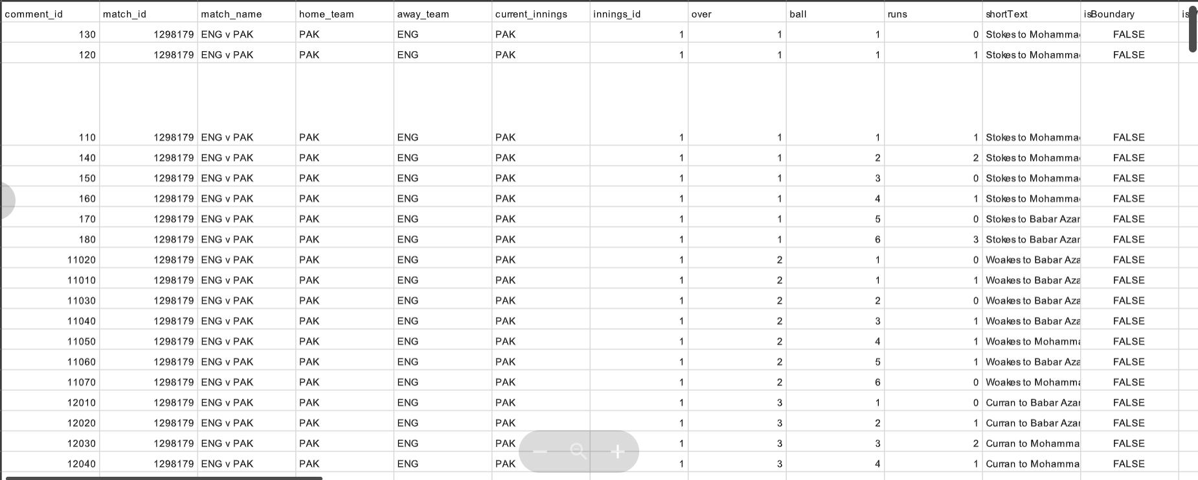
Data Set

Slide 6
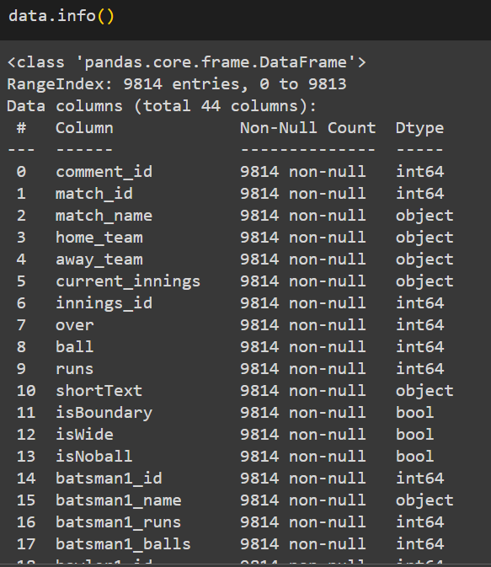
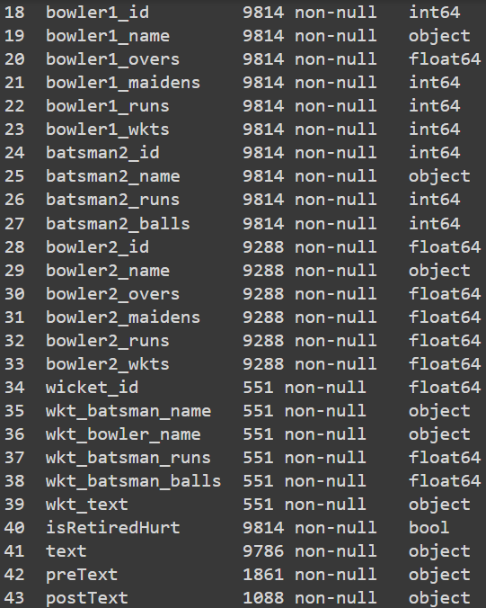
Dataset Info

Slide 7
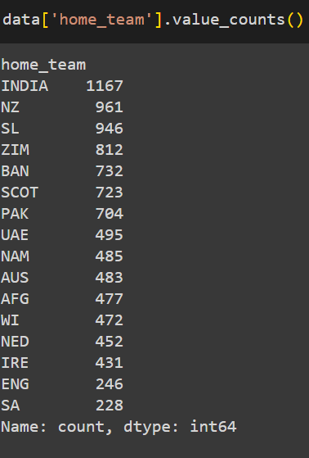
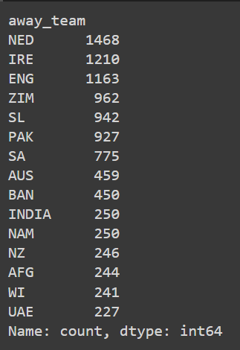
Value counts of Home team vs Away team

Slide 8
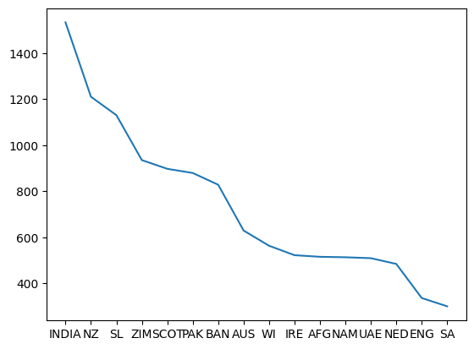
Most runs scored home team

Slide 9
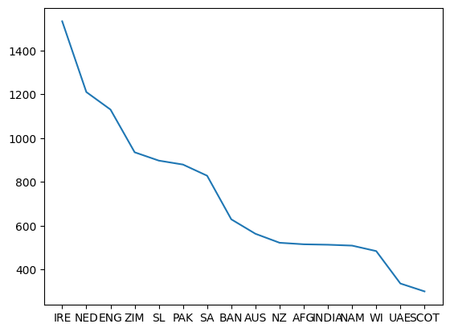
Most runs scored away team

Slide 10
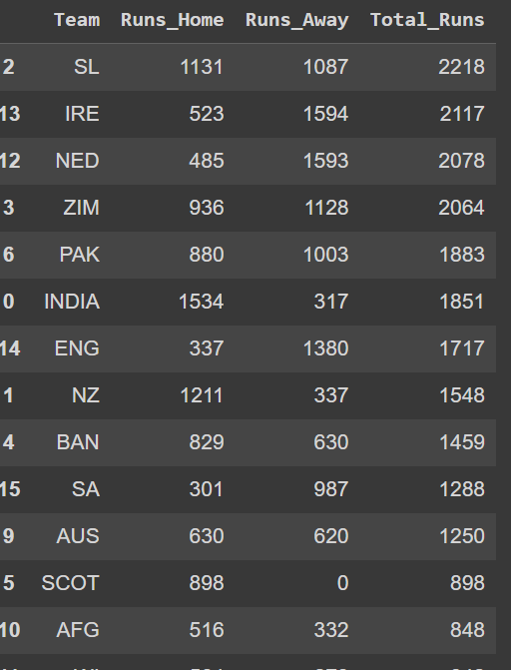
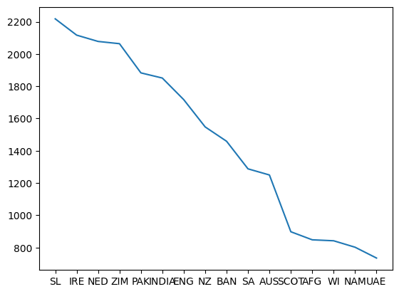
Most runs scored team

Slide 11
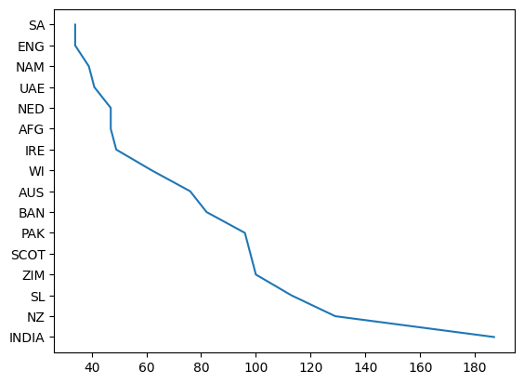
Boundaries scored by each team

Slide 12
Key points
India scored most runs as a home team
Netherland scored most runs as an away team
Sri Lanka scored most runs
India got 6th place
India hits more boundaries than others

Slide 13
Conclusion
This project presents a thrilling opportunity to analyze real-world T-20 cricket data and draw meaningful insights from it. By the end of this project, you'll have developed strong analytical skills, honed your data analysis techniques, and have the ability to provide a comprehensive understanding of the T-20 World Cup 2022.

Slide 14
THANK YOU

